Slide 1
Multimedia Systems Lecture – 19
By
Dr. Priyambada Subudhi
Assistant Professor
IIIT Sri City

Slide 2
Differential Pulse Code Modulation (DPCM)
It is based on differential predictive coding.
Audio is often stored not in simple PCM but in a form that exploits differences.
Generally, if a time-dependent signal has some consistency over time (temporal redundancy), the difference signal—subtracting the current sample from the previous one—will have a more peaked histogram, with a maximum around zero.
For a start, differences will generally be smaller numbers and hence offer the possibility of using fewer bits to store.

Slide 3

Suppose our integer sample values are in the range 0 .. 255. Then differences could be as much as −255 .. 255. So we have unfortunately increased our dynamic range (ratio of maximum to minimum) by a factor of two.
Let’s formalize our statement of what we are doing by defining the integer signal as the set of values f_{n}.
Then we predict values as simply the previous value, and we define the error e_{n} as the difference between the actual and predicted signals:
We certainly would like our error value e_{n} to be as small as possible.
Therefore, we would wish our prediction to be as close as possible to the actual signal f_{n}.

Slide 4

But for a particular sequence of signal values, some function of a few of the previous values, f_{n−1}, f_{n−2}, f_{n−3}, etc., may provide a better prediction of f_{n}.
The idea of forming differences is to make the histogram of sample values more peaked.
A plot of 1 second of sampled speech at 8 kHz, with magnitude resolution of 8 bits per sample is considered.
A histogram of these values is centered around zero. However, the histogram for corresponding speech signal differences: difference values are much more clustered around zero than are sample values themselves.
So we can assign short codes to prevalent values like zeros here and long codewords to rarely occurring ones.

Slide 5
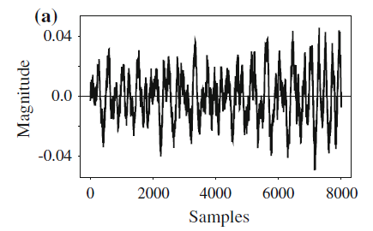
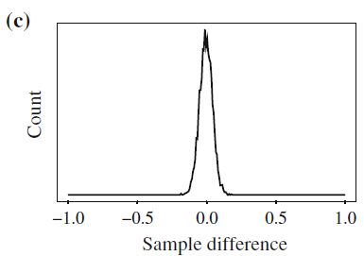
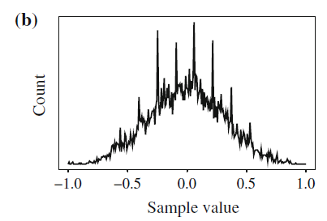
Differencing concentrates the histogram: a digital speech signal; b histogram of digital speech signal values; c histogram of digital speech signal differences

Slide 6
Suppose samples are in the range 0 .. 255, and differences are in −255 .. 255. Then
Define SU and SD as shifts by 32.
Then we could in fact produce code-words for a limited set of signal differences, say only the range −15 .. 16.
Differences (that inherently are in the range −255 .. 255) lying in the limited range can be coded as is, but if we add the extra two values for SU, SD, a value outside the range −15 .. 16 can be transmitted as a series of shifts, followed by a value that is indeed inside the range −15 .. 16.
For example, 100 is transmitted as SU, SU, SU, 4, where (the codes for) SU and for 4 are what are sent.

Slide 7

Example: suppose we devise a predictor for as follows:
Then the error e_{n} (or a codeword for it) is what is actually transmitted. Suppose we wish to code the sequence f1, f2, f3, f4, f5 = 21, 22, 27, 25, 22.
For the purposes of the predictor, we’ll invent an extra signal value f₀, equal to f1 = 21, and first transmit this initial value, uncoded; after all, every coding scheme has the extra expense of some header information.

Slide 8
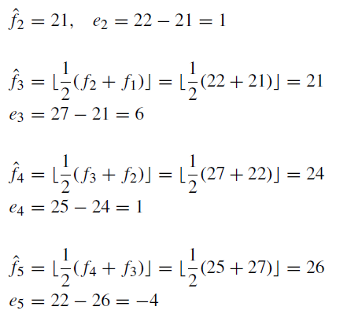
Then the first error, e1, is zero, and subsequently

Slide 9
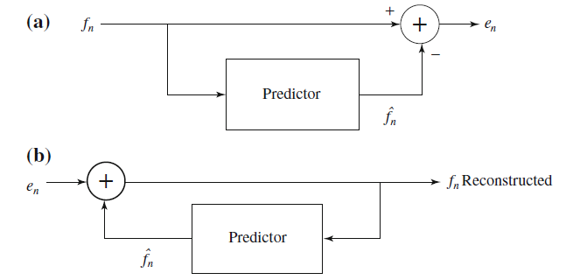
Schematic diagram for Predictive Coding: a encoder; b decoder

